Slide 1
COMPUTER ARCHITECTURE CSE - 323
Dept of CSE, MIST

Slide 2

Introduction

Slide 3

Introduction

Slide 4

Introduction

Slide 5
Introduction
Difference between this and that

Slide 6
This Course Introduces
The basic concepts of computers
Their design and how they work
Machine's instruction set architecture
Its use in creating a program and its implementation in hardware

Slide 7
High Level Goal of This Course
Under stand the principles
Understand the precedents
Based on such understanding :
Enable you to evaluates tradeoffs of different designs and ideas
Enable you to develop principle design
Enable you to develop novel and out of box designs
The focus is on
Principles and precedents and how to use them on new designs

Slide 8
Learning Outcome
This course will teach you how to become a good computer architect

Slide 9
I hope you are here for this
Programmer
Architect/ Microarchitecture view
How to design a computer that meets system design goal?
Choice -critically affects both the SW programmer and the HW designer
HW designer’s view – How a computer system works
Digital logic as a model of computation
‘C’ as a model of computation
Is my compiler efficient?
How does an assembling program ends up as executing digital logic?
What happens in between?
How is a computer designed using Logic gates and wires to satisfy specific goal?
Hardware Designer

Slide 10
Ways of Transformation
Problems
Algorithms
Program/Language
Runtime Systems (OS)
C
ISA (Architecture)
Microarchitecture
Logic
Circuit
Electron
‘Purpose of computing is insight’ (Richard Hamming)
We gain and generate insight by solving problems
How do we ensure problems are solved by electrons?

Slide 11
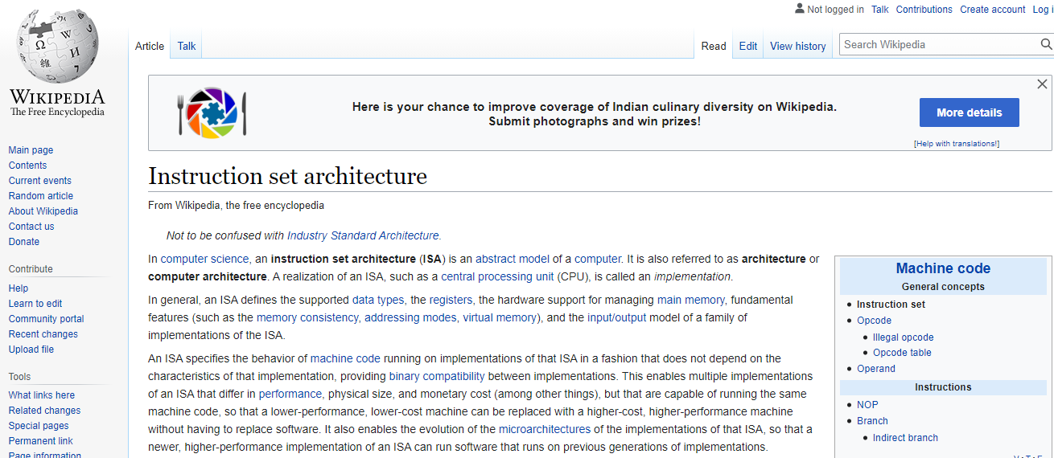
Instruction Set Architecture (ISA)
Notes:
The instruction set provide commands to the processor, to tell it what it needs to do. The instruction set consists of addressing modes, instructions, native data types, registers, memory architecture, interrupt, and exception handling, and external I/O.

Slide 12
The Power of Abstractions
Levels of transformation creates abstractions
Abstraction: A higher level only needs to know about the interface to the lower level, not how the lower level has been implemented
E.g., High level programmer does not really need to know what the ISA is and how a computer executes instructions
Abstraction improves productivity
No need to worry about decisions made in underlying levels
E.g., Programming in Java vs. C vs. Python vs. Assembly vs. binary by specifying control signals of each translator every cycle

Slide 13
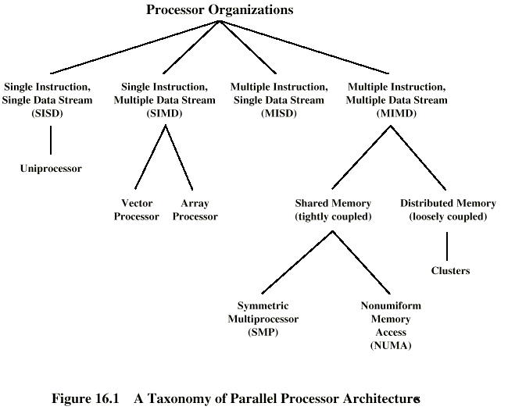
Single Processor to Multiprocessor
Notes:
A processor (CPU) is the logic circuitry that responds to and processes the basic instructions that drive a computer. The CPU is seen as the main and most crucial integrated circuitry (IC) chip in a computer, as it is responsible for interpreting most of computers commands.
A processor must have 3 functional units to be what we call a computer: a unit that performs arithmetic and logical operations on data (aka the ALU); a unit that remembers data while it isn’t being worked on (aka the Memory); and a unit which sequences the operations performed by the ALU and on which data (aka the Sequencer).“Processor organization” is a term describing how those three elements(arithmetic unit,logical unit and control unit) are implemented and how they interconnect to accomplish their tasks.

Slide 14
Memory Performance Hog
All major high-performance processor manufacturers have integrated at least two cores (processors) on the same chip
Most of the PC is having multicore processor
As cores on the same chip share the DRAM memory system, multiple programs executing on different cores can interfere with each others’ memory access requests, thereby adversely affecting one another’s performance.
An application can maliciously destroy the memory-related performance of another application running on the same chip. We call such an application a memory performance hog (MPH)

Slide 15
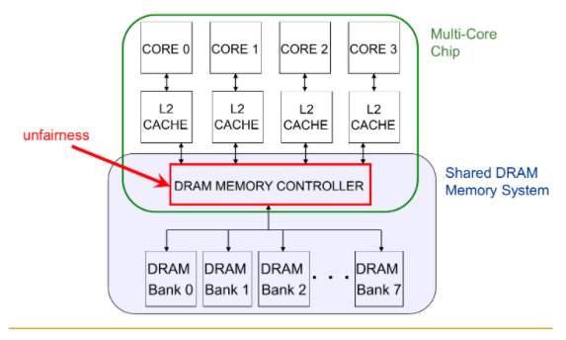
Performance Degradation
C
Py
R
A

Slide 16
Performance Degradation
// initialize arrays a, b
for (j=0; j<N; j++)
index[j] = j; // streaming index
// initialize arrays a, b
for (j=0; j<N; j++)
index[j] = rand(); // random # in [0,N]
STREAMING
Sequential memory access
Very high row buffer locality (96% hit rate)
Memory intensive
RANDOM
Random memory access
Very low row buffer locality (3% hit rate)
Memory intensive

Slide 17
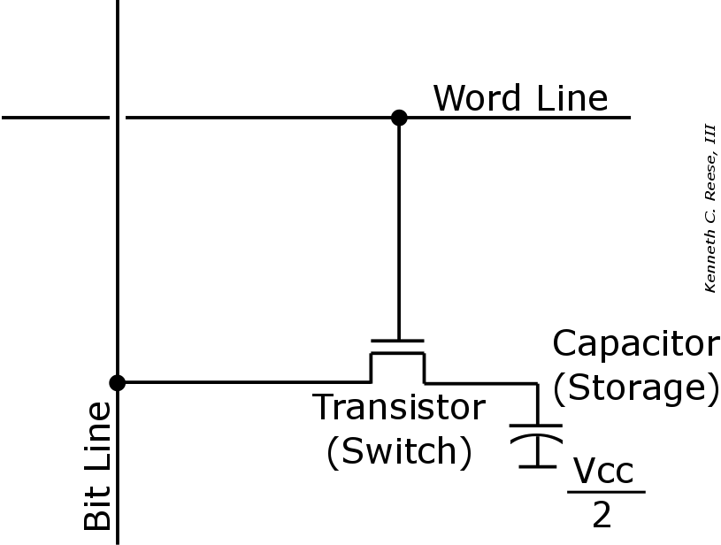
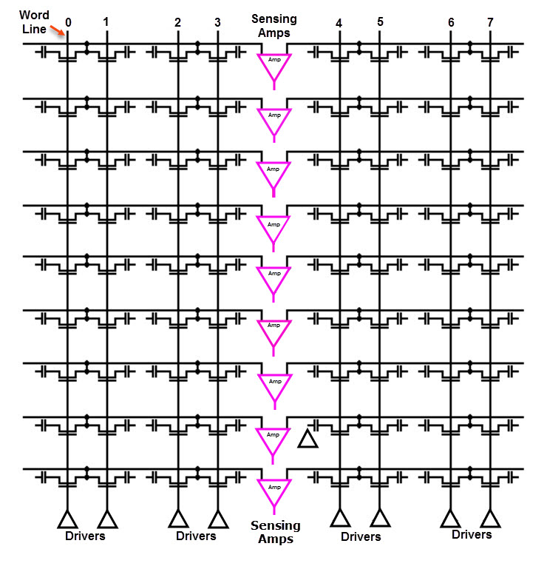
Dynamic RAM
3 PROBLEMS
Inefficient bulk data movement.
DRAM refresh interference. While DRAM is being refreshed, it can't all be accessed.
Cell latency variation, due to manufacturing variability.
Single bit

Slide 18
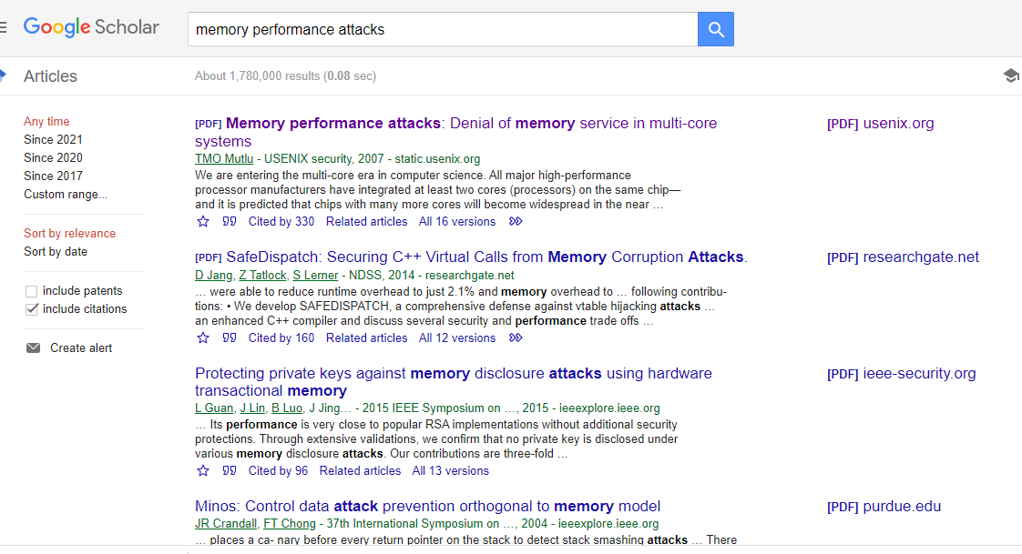
Performance Degradation

Slide 19
What happened underneath
How would we solve the problems?
What is the right place to solve the problems?
Programmer?
System software?
Compiler?
Hardware (memory controller)?
Hardware (DRAM)?
Circuits?
Problems
Algorithms
Program/Language
Runtime Systems (OS)
VM, I/O Module, MM
ISA (Architecture)
Microarchitecture
Logic
Circuit
Electron

Slide 20
Course Schedule
Lt Cdr S M Anisur Rahman
Topic | Week
History of Computers | 1
A Top-Level View of Computer Function and Interconnection | 3
Internal Memory | 5
Input/ Output | 7
Operating System Support | 8
Parallel Processing | 12
Reserved Week for Revision | 14

Slide 21
Course Schedule
Lec Afia Anjum
Topic | Week
Computer Performance | 2
Cache Memory | 4
External Memory | 6
Computer Arithmetic | 9
Reduced Instruction Set Computers | 10
Instruction Set and Processor Organization | 11
Superscalar Processors | 13

Slide 22
Teaching Learning Strategy
Teaching and Learning Activities | Engagement (hours)
Face-to-Face Learning
Lecture | 42
Practical / Tutorial / Studio | -
Student-Centred Learning | -
Self-Directed Learning
Non-face-to-face learning | 42
Revision | 21
Assessment Preparation | 21
Formal Assessment
Continuous Assessment Mid-Term Final Examination | 2 1 3
Total | 132

Slide 23
Assessment Strategy
Components |  | Grading
Continuous Assessment (40%) | Test 1-3 | 20%
 | Class Participation | 5%
 | Mid term | 15%
Final Exam |  | 60%
Total Marks |  | 100%

Slide 24
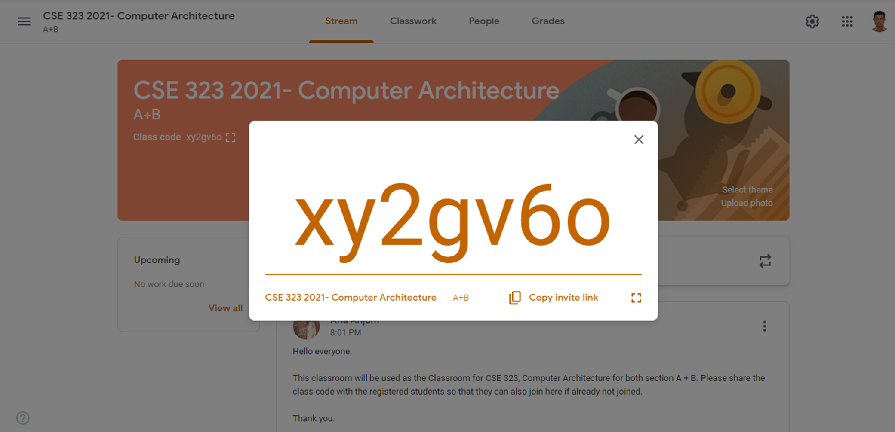
Google Classroom
Link invitation https://classroom.google.com/c/Mjc3NzcxNjQxNjYx?cjc=xy2gv6o

Slide 25
Reference Books
Computer Organization and Architecture, 9th Edition – William Stalling
Computer Organization and Design, 4th Edition – David A Patterson
Structured Computer Organization, 6th Edition – Andrew S. Tanenbaum

Slide 26

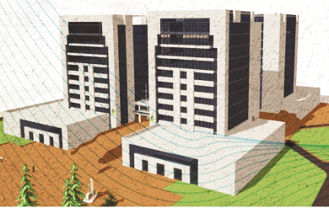
Thank You

